Slide 1
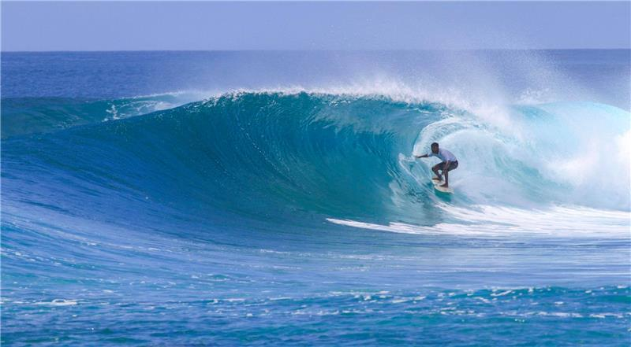
SAVE THE DATE
18TH-20ST September 2019
*$50 deposit to the front office ASAP

